Slide 1
Glass, Paint, and Soil Evidence
Lab Exams of Glass Evidence:
  Fracture edges can be made to fit jigsaw puzzle style.
  Matches can be made to the size of a pinhead
  Matches can be made to breaks with conchoidal striations or other marks called “gackle” marks.

Slide 2
Direction of Force
Direction of force can be determined when a piece of glass is broken.
Direction of a bullet fired through glass can be determined.
The sequence of bullets fired through glass can be determined.
It can be determined if glass broke due to fire/heat or by mechanical force.

Slide 3
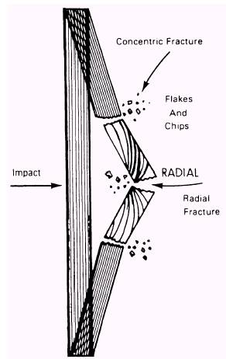
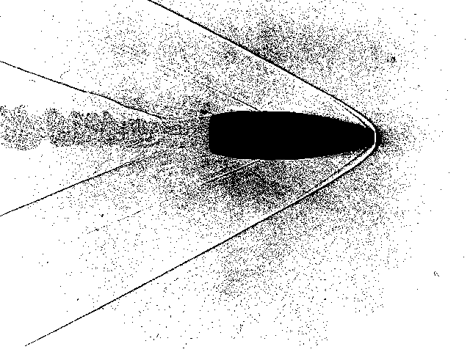
Direction of Path of Bullet

Slide 4
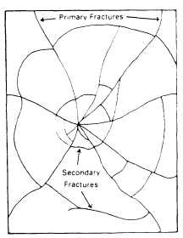
Primary/Secondary Fractures

Slide 5
Physical Properties of Glass
Color of glass permits analyst to screen glass fragments
Curvature of surface, thickness of the glass, and surface texture
Most popular analysis of glass involved:
  a. Refractive index
  b. Density of the glass

Slide 6
Physical Properties of Glass
Refractive Index:
  A measure of how much the glass will bend light rays passing through the glass.
Density:
  A measure of the relative mass (weight = mass x gravity) of a substance per unit volume. (1 cf of iron vs. 1 cf of glass)

Slide 7
Lab Opinions
Fracture Match:
  Analyst can give a positive opinion that questioned fragment matches known specimen.
Physical Properties
  Analyst can only indicate that the two could have a common origin

Slide 8
Collection of Glass Evidence
Clothing:
  Wrap each article in separate paper bags.
  Label each bag w/standard identification
  Dry wet or bloodstained clothing before packaging.

Slide 9
Collection of Glass Evidence
Tools:
  Place in smallest container in which evidence will fit.
  Do not pack w/cotton or other protective materials directly touching object.
  Wrap in butcher paper or brown paper and then pack w/crumpled paper or packing materials.
  Seal the package. Do not use glass.

Slide 10
Collection of Glass Evidence
Large Fragments:
  Place in sealed paper bindle or a folded and sealed paper or plastic bag or pill box.
  Wrap the paper or plastic bag with cushioning material (crumpled paper or bubble pak)
  Place in large cardboard box. No glass
  Record side of glass (inside or outside)

Slide 11
Paint Evidence
One of the more common types of evidence encountered.
  Hit and run
  Burglary cases
Most evidence submitted to a lab is automotive paint.

Slide 12
Paint Evidence
Paints belong to a class of substances referred to as: “protective coatings”
Protective Coating: used to coat surfaces to prevent rust or prevent environmental damage.

Slide 13
Paint Evidence
Hit and Run:
  Evidence as smear or flake
  Can show color of car involved (or area)
  Might indicate manufacturer and year model
  Chips can indicate re-painting of vehicle
  Large chips might be matched to paint remaining on car

Slide 14
Paint Evidence
Burglary cases:
  Paint markings on tools
  Plaster and safe insulation on tools also
  Wrap end of tool in paper bag and seal with plastic tape to prevent loss
  Never attempt to fit the tool into marks or impressions found at the crime scene
  Ruins significance of evidence on tool
  Exmaine tool for other trace evidence.

Slide 15
Lab Examinations of Paint Evidence
Examinations:
  First examine w/stereoscopic microscope (low power)
  Remove evidence for optical, chemical and spectroscopic analysis
  Optical methods = stereomicroscopic exams of colors, layers present, texture of surface and layer edges.

Slide 16
Lab Examinations of Paint Evidence
Examinations:
  Chemical Analysis:
    Wet chemistry for the solubility of the paints
      Indicates basic paint type present
  Spectroscopic Analysis
    Further characterize the type of paint and provide additional criteria for comparison between known and unknown.

Slide 17
Collecting Paint Specimens
When collecting paint samples, collect samples as close to the damaged area as possible.
Even though paint looks the same, it can change in type and composition very rapidly. (Fig. 7.1)

Slide 18
Paint Samples from Garments
Take the entire garment from scene
If damp or bloody, let dry
Package in paper bags
Roll garment in paper
Seal bag containing garment

Slide 19
Packaging Paint Evidence
Small glass vials or cardboard pill boxes are very good.
Paint samples are hard to get out of plastic containers.
Wrap in paper bindles when possible then place in containers.
If placed in envelope make sure it is properly sealed to prevent loss of evidence

